Slide 1
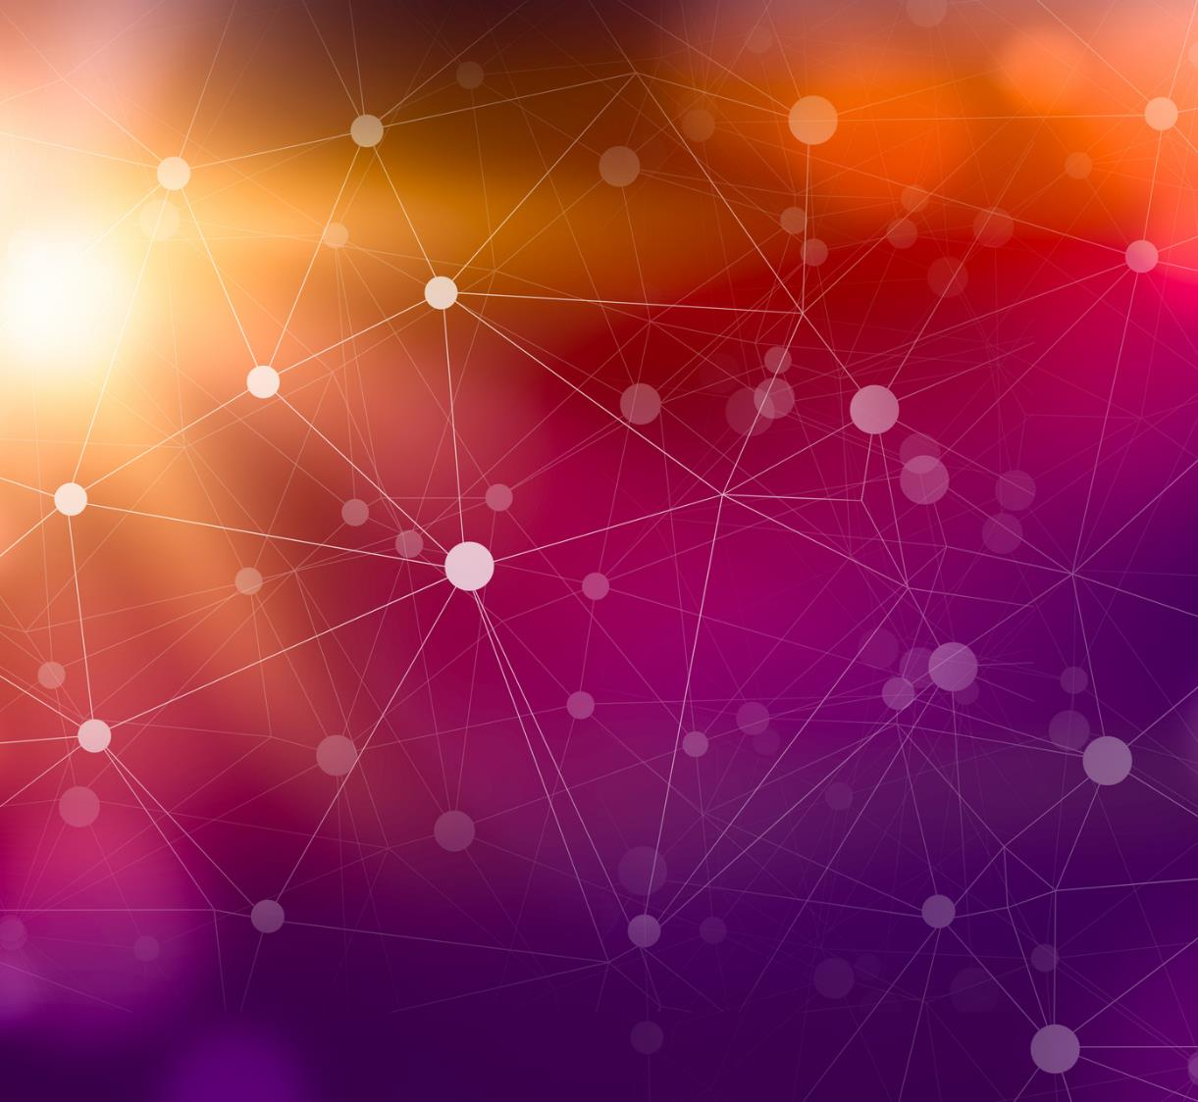
Differential Privacy for Mobility Data used in Epidemiological Models

Slide 2
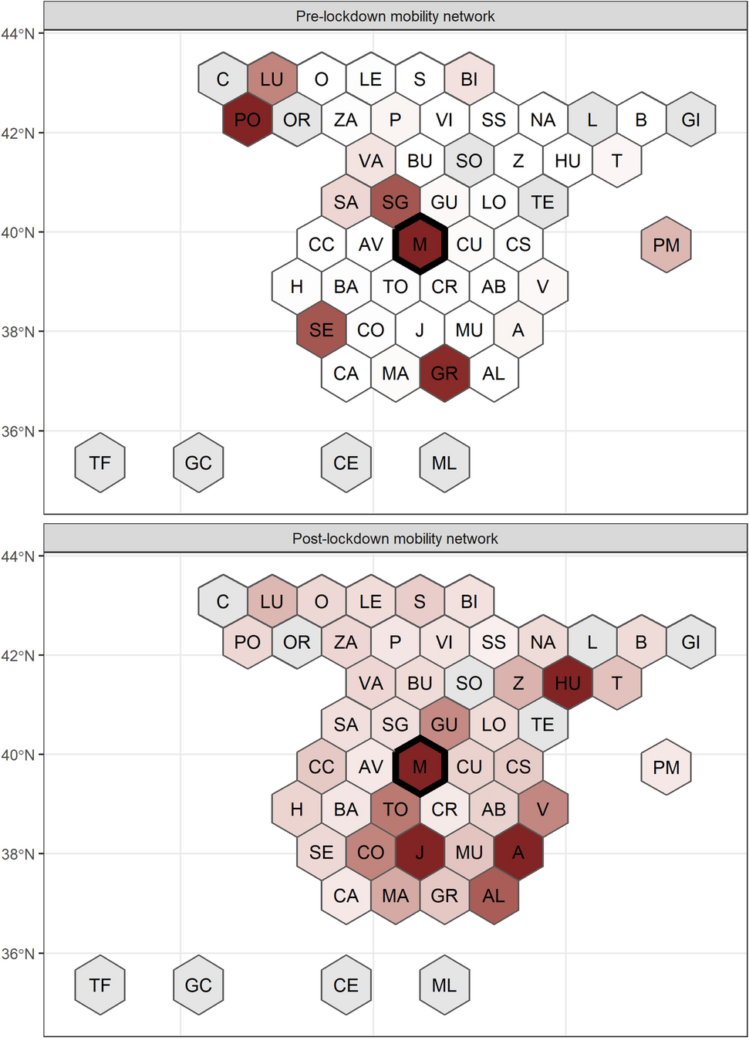
Mobility data are used in epidemiological metapopulation models
Kishore, N., Kahn, R., Martinez, P.P. et al. Lockdowns result in changes in human mobility which may impact the epidemiologic dynamics of SARS-CoV-2. Sci Rep 11, 6995 (2021). https://doi.org/10.1038/s41598-021-86297-w

Slide 3
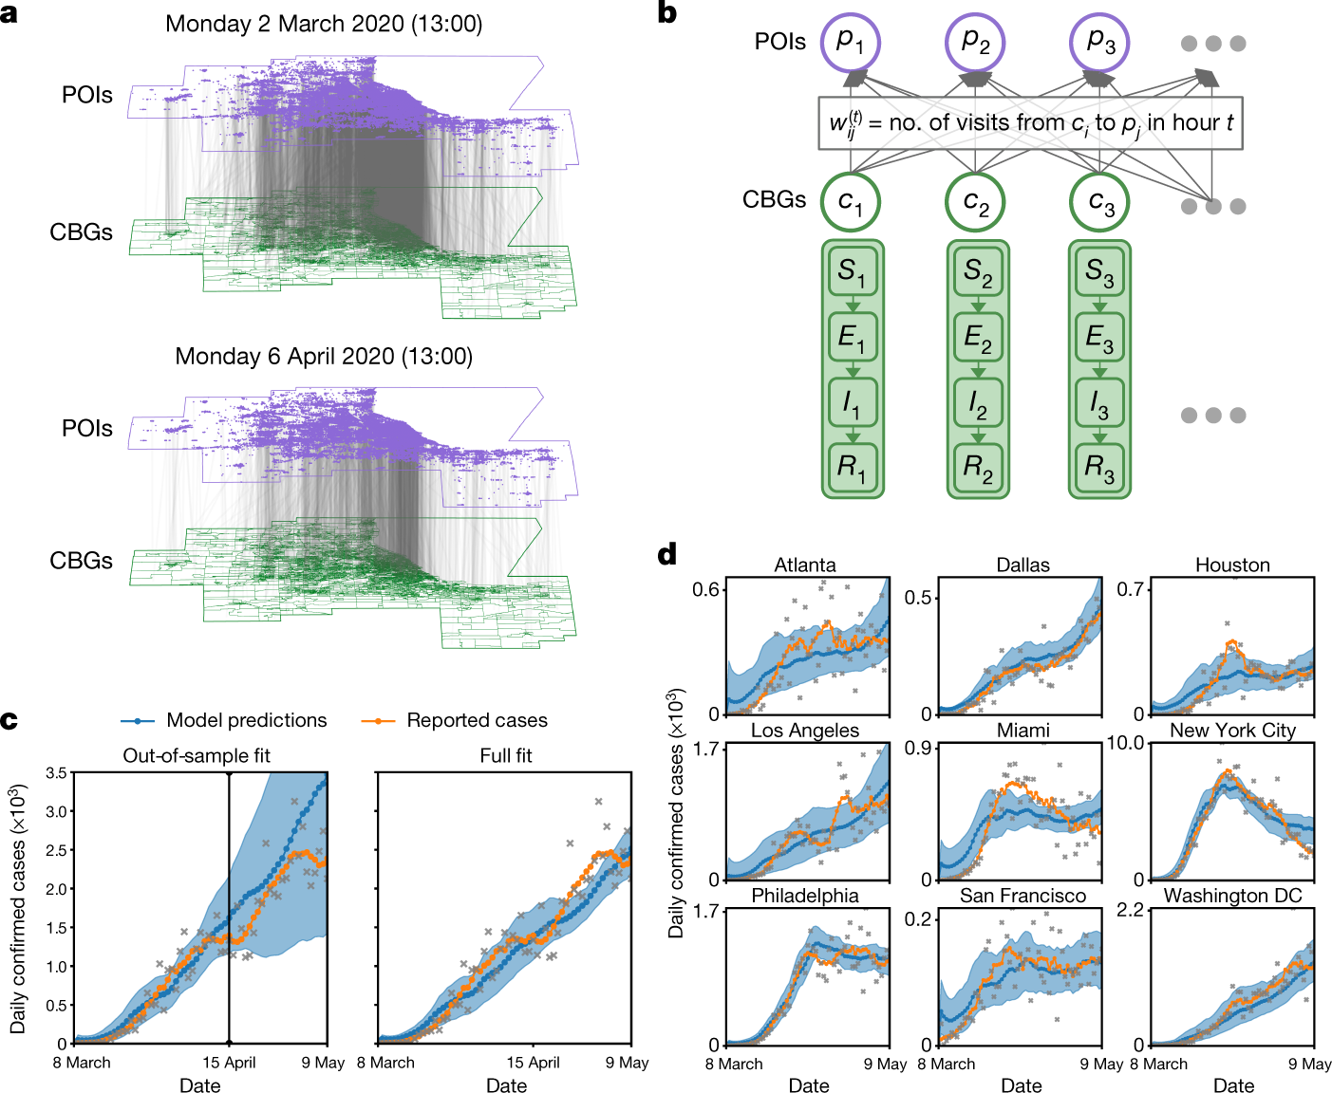
These models can guide recommendations on resource allocation like vaccine distribution
Chang, S., Pierson, E., Koh, P.W. et al. Mobility network models of COVID-19 explain inequities and inform reopening. Nature 589, 82–87 (2021). https://doi.org/10.1038/s41586-020-2923-3

Slide 4
The use of these data requires balancing two key components
Preservation of Privacy
Valid estimation of epidemiological parameters
The users trust that the researcher using mobility data protects the identity of those individuals who produce them
The users trust that unique experiences are incorporated into the model outputs which guide resource allocation

Slide 5
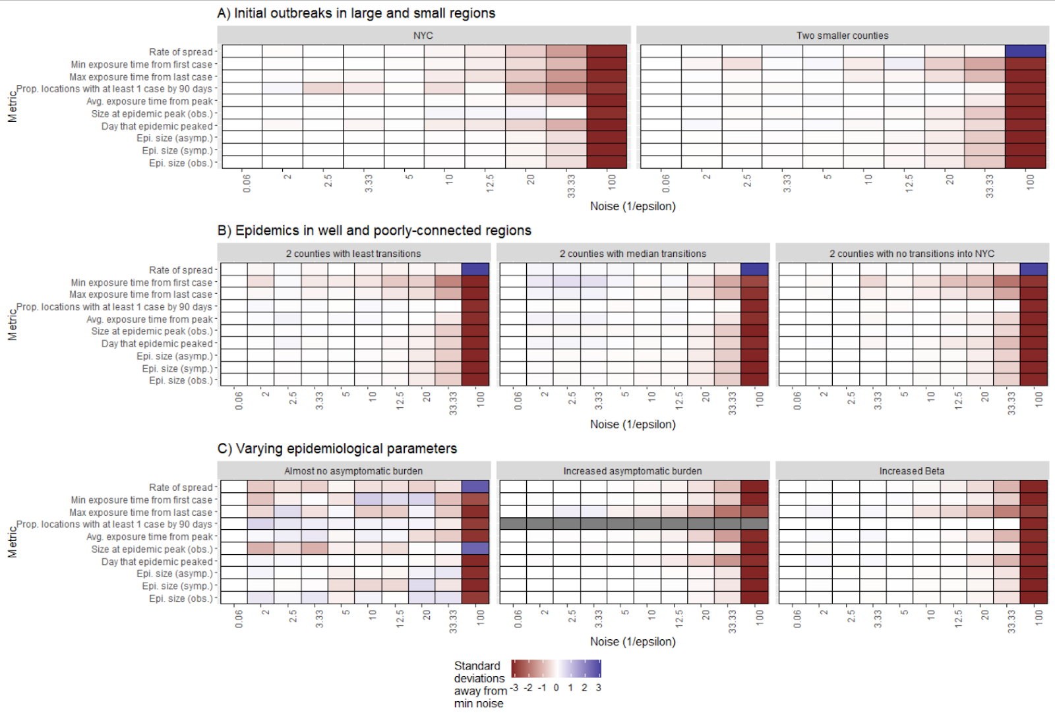
Differential Privacy offers a robust method to meet this demand
As we incorporate privacy preserving noise, most epidemiological metrics of interest remain unbiased till we reach very high levels of noise

Slide 6
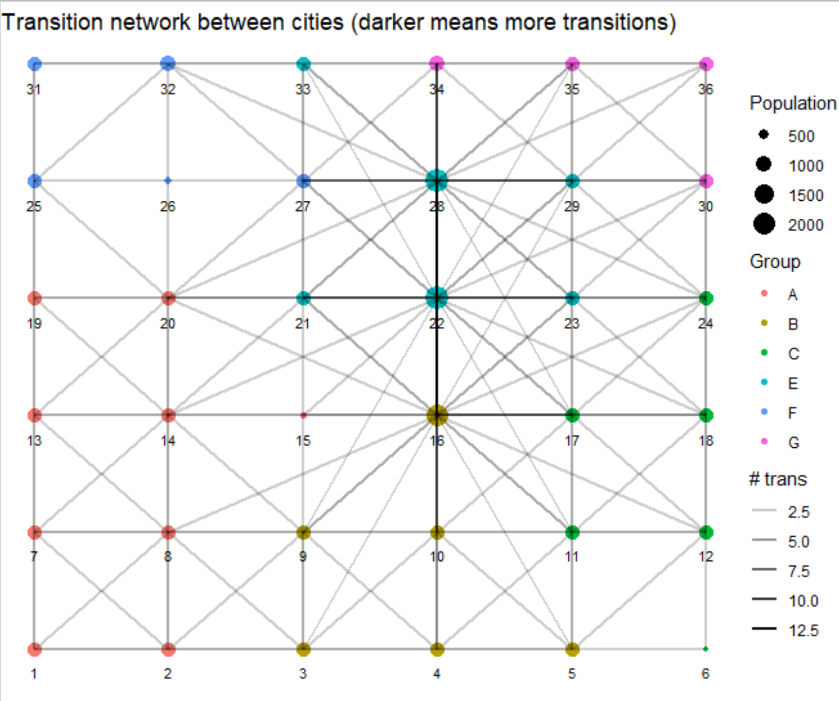
What does application of DP to mobility data mean?
Try out our demo and find out!

Slide 7







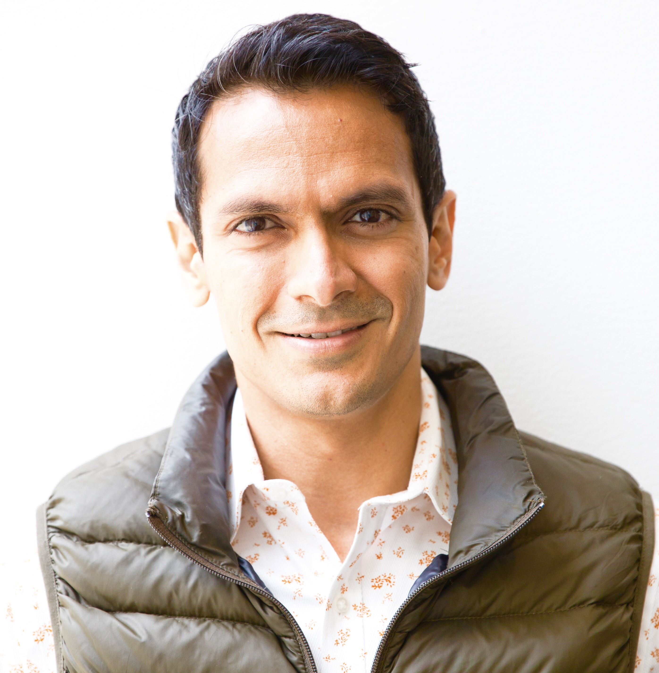

Team
Akash Yadav
Andrew Schroeder
Caroline Buckee
Koissi Savi
Navin Vembar
Nishant Kishore
Salil Vadhan
Satchit Balsari
Wanrong Zhang

